Slide 1

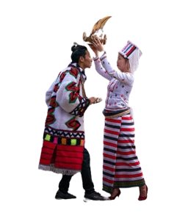
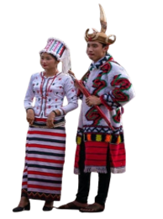
Hybrid Approach to Rawang Language Word Segmentation
Using Part-of-Speech Tagging
Supervised by
Second Seminar
Presented by
Dr. Naw Thiri Wai Khin
2.8.2024
Mg Mabu Phong(6IST-21)

Slide 2
Outlines
Abstract
Objectives
Scope of Thesis
Rawang Language Structure
Theory Background
System Design
Output
Benefits
Limitations
Conclusion
1

Slide 3
Abstract
Natural Language Processing, or NLP, is a field that teaches computers to understand human language.
NLP aims to achieve powerful tasks such as machine translation, text summarization, and information retrieval and so on.
To enhance accuracy in these areas, foundational NLP processes are essential.
The proposed system targets Rawang word segmentation and Part-Of-Speech (POS) tagging, representing foundational processes in NLP.
Word segmentation is achieved using the Maximum Matching Algorithm using Rawang words corpus.
POS tagging is implemented through Conditional Random Fields model using metrics, refining as needed.
2

Slide 4
Objective
To preserve Rawang language representing our preserved culture
To develop a diverse Rawang language corpus
To perform word segmentation using Maximum matching algorithm
To design a tailored CRF model for precise Rawang POS tagging
3

Slide 5
Scope of Thesis
1
Rawang word corpus and POS tag corpus creation
Word Segmentation with Maximum Matching Algorithm
2
3
Training POS tag corpus with Conditional Random Field
Creating Graphical User Interface for predicting input sentence
4
4

Slide 6
Corpus Creation
1
Unduplicated Word Corpus
2
Labeled-Sentences Corpus
shv̀msòpuq
tiberia
shvlo
lvwà
ma
ínìgø
zv́ng
má
dakngòe
Dvtuq
vrá/CONJ tiqpè/N nø/AUX shvt/V bǿà/CV
íwe/CONJ nàmaq/PRO í/C kadø/IR dèdvm/V nø̀ng/P e/CV
yesu/N í/C àngmaq/PRO sv̀ng/C vtán/V òe/CV
àngmaq/PRO sv̀ng/C dvban/V ò/P e/CV
nà/PRO mvtu/N è/PF lvng/V shì/SF nø̀/CONJ è/PF lo/V
nvpè/N nvmè/N sv̀ng/C nàpǿ/V ò/P
2500 words
3000 sentences
5

Slide 7
Rawang Language Structure
Type of Rawang characters | Detail
22 Consonants | G K Q H N NG J CH SH Y R D T S Z N B P L W M C NY
7 Vowels | I E A U Ø O
4 Diacritics | á ā à aq
Punctuations | . , ? ! : ; -
10 Digits | 0 1 2 3 4 5 6 7 8 9
6

Slide 8
Cont’d
Mvrà zìbè nø shìlòng íe. (အပြစ်၏အခကားသေခြင်းဖြစ်သည်)
Vsv̀ng dvrè kǿa mvdaq. (သူတစ်ပါးဥစ္စာမခိုးရ)
Nà kagǿ è íe? (မင်းဘယ်သူလဲ)
Word segmentation or tokenization is a process of dividing a continuous text into separate words or tokens.
Word segmentation complexity depends on the nature of each language.
In the Rawang language, there is an explicit space between individual words or phrases, simplifying the process of word segmentation.
In this proposed system, bidirectional matching is utilized for efficient tokenization.
7

Slide 9
Text Preprocessing
Transforming to lowercase
Removing punctuations
Removing special characters
input_text = “ Mvrà zìbè nø shìlòng íe. Vsv̀ng dvrè kǿa mvdaq. Vsv̀ngò svma dvchap mvdaq? ”
segmented_words = bidirectional_maximum_matching (input_text)
#segmented words:
[['mvrà','zìbè','nø','shì’,lòng','í','e'],['vsv̀ng','dvrè','kǿ','a','mv','daq'],['vsv̀ng','ò','svma','dvchap','mv','daq']]
8

Slide 10
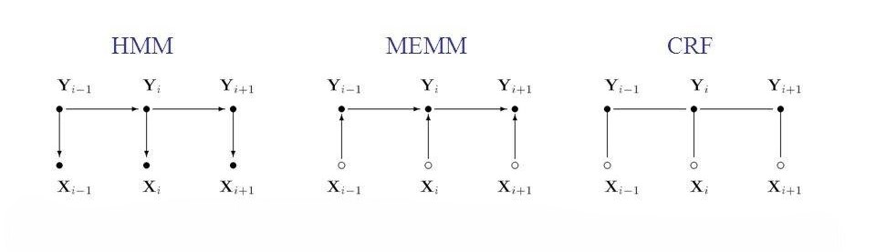
Theory Background
CRF is a powerful probabilistic graphical model used primarily for sequential data labeling tasks.
Unlike traditional models, CRFs consider the entire sequence of labels collectively rather than treating each label independently.
It can handle long-range dependencies than traditional model such as HMM, MEMM.
9

Slide 11
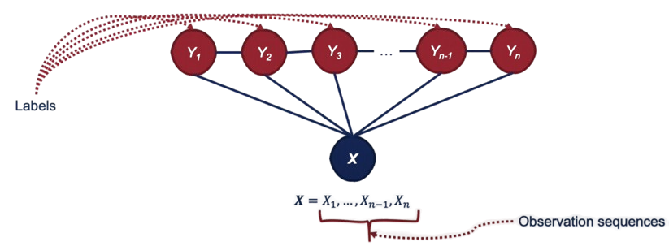
Special Case of Markov Random Fields
Undirected graphical model
10

Slide 12
Conditional Random Fields
Let X be the input features and Y be the output sequence. The joint probability distribution of a CRF is given by:
where:
Z(X) is the normalization factor
f_{k}(y_{i} – 1, y_{i}, x_{i}) are the feature functions that take as input the current output state y_{i}, the previous output state y_{i} – 1, and the input features x_{i}.
11

Slide 13
CRF for POS Tagging
Sequence Labeling: CRFs are well-suited for POS tagging as they treat the problem as a sequence labeling task, assigning a POS tag to each word in a sentence.
Feature Functions: CRFs rely on feature functions that capture various characteristics of the input data, such as word identity, capitalization, prefix/suffix, and surrounding context.
Training: During training, CRFs learn the weights of these feature functions to maximize the likelihood of the correct tag sequence given the input words.
Optimization :Limited-memory Broyden–Fletcher–Goldfarb–Shanno (lbfgs) is used for parameter estimation.
12

Slide 14
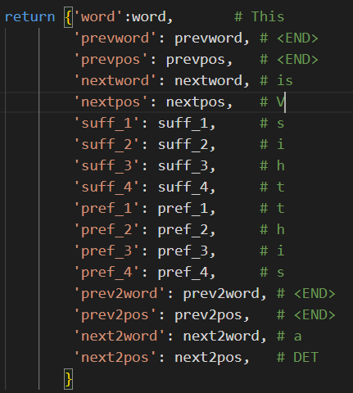
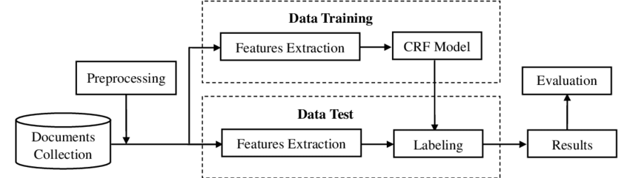
Feature Extraction (Cont’d)
The word itself.
POS tag of the word.
Previous word.
POS tag of previous word.
Second previous word to the given word.
POS tag of second previous word.
Next word.
POS tag of next word.
This/PRO is/V a/DET word/N.
13

Slide 15
Rawang POS Tag Sets
Noun (N)
Pronoun (PRO)
Verb (V)
Preposition (PREP)
Adjective (ADJ)
Adverb (ADV)
Conjunction (CONJ)
Particle (PRT)
Interrogative (IR)
Number (NUM)
Number Text (NT)
Chronological Verb (CV)
Case(C)
Demonstrator (DM)
14

Slide 16
System Design
start
Input Rawang text
Sentence Segmentation
Word Segmentation
Maximum Matching Algorithm
Word Corpus
POS Tagging
CRF Model
Labeled Corpus
Display words with tags
End
15

Slide 17
Output
OUTPUT
Input sentence : Yesukristu shøqyanga dang nø íe.
Segmented Words : Yesu kristu shøq yanga dang nø í e .
Pos Tags : noun noun verb adj noun adp verb chro .
16

Slide 18
Benefits
This system helps preserve the Rawang language by creating a structured digital corpus, ensuring the language is documented and accessible for future generations.
The POS tagging system serves as an educational tool for teaching and learning the Rawang language, providing resources for schools and language enthusiasts within the community.
This system lays the groundwork for more advanced NLP applications, such as machine translation, speech recognition, and sentiment analysis, tailored to the Rawang language.
This system is developed under an open-source license, allowing it to be freely used for any research purposes.
17

Slide 19
Limitations
The proposed system is organized by a total of nearly 2,500 words for word segmentation and nearly 3,000 labeled-sentences for POS tagging.
Segmentation error can occur when the words are not listed in Corpus and can effect the accuracy of POS tagging
The bidirectional matching algorithm used for word segmentation has inherent weaknesses.
CRFs require a large amount of labeled training data to learn accurate weights, which can be a limitation for languages or domains with limited annotated data.
18

Slide 20
Conclusion
Tokenization is a crucial step before POS tagging because POS tagging relies on the individual tokens to assign the correct grammatical category.
POS tagging is commonly performed after word segmentation or tokenization.
Precise foundational analysis in NLP enhances advanced tasks such as machine translation, summarization, information extraction, and more.
19

Slide 21
Future Work
Rawang Word Corpus creation
Labeled Corpus creation
Testing Word Segmentation
Training labeled corpus with CRF Model
Linking Word Segmentation and Part-of-Speech Tagging
Building Graphical User Interface
20

Slide 22
Thank You!

